Slide 1

Forecasting
4
PowerPoint presentation to accompany
Heizer and Render
Operations Management, Eleventh Edition
Principles of Operations Management, Ninth Edition
PowerPoint slides by Jeff Heyl
© 2014 Pearson Education, Inc.

Slide 2
Outline
Global Company Profile:
Walt Disney Parks & Resorts
What Is Forecasting?
The Strategic Importance of Forecasting
Seven Steps in the Forecasting System
Forecasting Approaches

Slide 3
Outline - Continued
Time-Series Forecasting
Associative Forecasting Methods: Regression and Correlation Analysis
Monitoring and Controlling Forecasts

Slide 4
Learning Objectives
When you complete this chapter you should be able to :
Understand the three time horizons and which models apply for each use
Explain when to use each of the four qualitative models
Apply the naive, moving average, exponential smoothing, and trend methods

Slide 5
Learning Objectives
When you complete this chapter you should be able to :
Compute three measures of forecast accuracy
Develop seasonal indices
Conduct a regression and correlation analysis
Use a tracking signal

Slide 6

Forecasting Provides a Competitive Advantage for Disney
Global portfolio includes parks in Hong Kong, Paris, Tokyo, Orlando, and Anaheim
Revenues are derived from people – how many visitors and how they spend their money
Daily management report contains only the forecast and actual attendance at each park
© 2014 Pearson Education, Inc.

Slide 7
Forecasting Provides a Competitive Advantage for Disney
Disney generates daily, weekly, monthly, annual, and 5-year forecasts
Forecast used by labor management, maintenance, operations, finance, and park scheduling
Forecast used to adjust opening times, rides, shows, staffing levels, and guests admitted
© 2014 Pearson Education, Inc.

Slide 8
Forecasting Provides a Competitive Advantage for Disney
20% of customers come from outside the USA
Economic model includes gross domestic product, cross-exchange rates, arrivals into the USA
A staff of 35 analysts and 70 field people survey 1 million park guests, employees, and travel professionals each year
© 2014 Pearson Education, Inc.

Slide 9
Forecasting Provides a Competitive Advantage for Disney
Inputs to the forecasting model include airline specials, Federal Reserve policies, Wall Street trends, vacation/holiday schedules for 3,000 school districts around the world
Average forecast error for the 5-year forecast is 5%
Average forecast error for annual forecasts is between 0% and 3%
© 2014 Pearson Education, Inc.

Slide 10
What is Forecasting?
Process of predicting a future event
Underlying basis
of all business and project decisions
  Production
  Inventory
  Personnel
  Facilities
  Project
??

Slide 11
Forecasting Time Horizons
Short-range forecast
  Up to 1 year, generally less than 3 months
  Purchasing, job scheduling, workforce levels, job assignments, production levels
Medium-range forecast
  3 months to 3 years
  Sales and production planning, budgeting
Long-range forecast
  3⁺ years
  New product planning, facility location, research and development

Slide 12
Distinguishing Differences
Medium/long range forecasts deal with more comprehensive issues and support management decisions regarding planning and products, plants and processes
Short-term forecasting usually employs different methodologies than longer-term forecasting
Short-term forecasts tend to be more accurate than longer-term forecasts

Slide 13
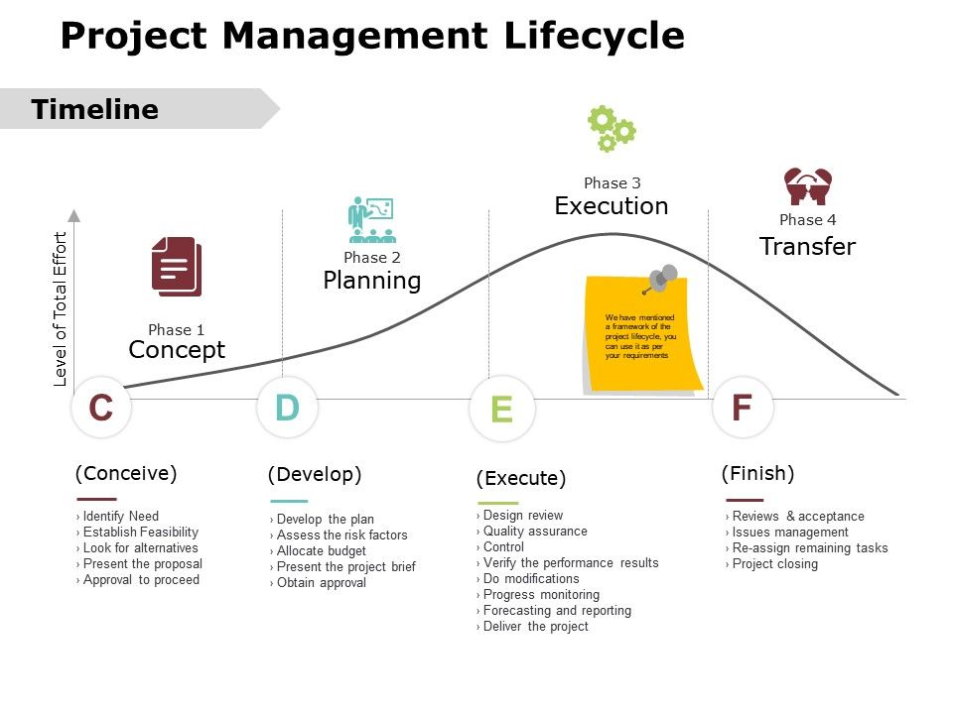


Slide 14
The Basics Of Forecasting For Project Management
forecasting is an extremely important element of the initiation stages of project management. During the initiation and planning stages, project managers will often complete "Forecasting" exercises to determine the project's scope, possible constraints, and potential risks. All of these factors require a project manager to be as accurate as possible when making his or her predictions about any aspect of a given project's life cycle.

Slide 15
Types of Forecasts
Economic forecasts
  Address business cycle – inflation rate, money supply, Trade Balance, etc.
Technological forecasts
  Predict rate of technological progress (4g-5g)
  Impacts development of new products (new iPhone)
Demand forecasts
  Predict sales of existing products and services
  (forecasting of air conditioner in summer)

Slide 16
Strategic Importance of Forecasting
Supply-Chain Management – Good supplier relations, advantages in product innovation, cost and speed to market Apple (Daily updates of sales), Toyota and imtiaz super store in ramzan , Walmart Collaborate planning forecast and replenishment with P&G (CPFR) Collaborative Planning, Forecasting and Replenishment
Human Resources – Hiring, training, laying off workers
Capacity – Capacity shortages can result in undependable delivery, loss of customers, loss of market share Kababjees

Slide 17
Strategic Importance of Project Forecasting
Forecasts can be made with respect to project duration, overall project cost, performance/quality level of project deliverables, or any combination of these.
A key element in forecasting is to review the risk events that occurred and the remaining risk triggers. A caution when doing forecasting, ensure you have adequate information to realistically forecast performance.
A general rule of thumb is to wait until an activity, phase, or deliverable is at least 25% - 40% complete before trying to forecast.
Most projects would not be undertaken if management had little confidence in a successful outcome.

Slide 18
Case 2
Forecasting at Olive Garden
It’s Friday night in the college town of Gainesville, Florida, and the local Olive Garden restaurant is humming. Customers may wait an average of 30 minutes for a table, but they can sample new wines and cheeses and admire scenic paintings of Italian villages on the Tuscan-style restaurant’s walls. Then comes dinner with portions so huge that many people take home a doggie bag. The typical bill: under $15 per person. Crowds flock to the Darden restaurant chain’s Olive Garden, Seasons 52, and Bahama Breeze for value and consistency— and they get it. Every night, Darden’s computers crank out forecasts that tell store managers what demand to anticipate the next day. The forecasting software generates a total meal forecast and breaks that down into specific menu items. The system tells a manager, for instance, that if 625 meals will be served the next day, “you will serve these items in these quantities. So before you go home, pull 25 pounds of shrimp and 30 pounds of crab out, and tell your operations people to prepare 42 portion packs of chicken, 75 scampi dishes, 8 stuffed flounders, and so on.” Managers often fine-tune the quantities based on local conditions, such as weather or a convention, but they know what their customers are going to order.
By relying on demand history, the forecasting system has cut millions of dollars of waste out of the system. The forecast also reduces labor costs by providing the necessary information for improved scheduling. Labor costs decreased almost a full percent in the first year, translating into additional millions in savings for the Darden chain. In the low-margin restaurant business, every dollar counts.
Sources: InformationWeek (April 1, 2014); USA Today (Oct. 13, 2014); and FastCompany (July-August 2009).

Slide 19
Seven Steps in Forecasting
Determine the use of the forecast
Select the items to be forecasted
Determine the time horizon of the forecast
Select the forecasting model(s)
Gather the data needed to make the forecast
Make the forecast
Validate and implement results

Slide 20
The Realities!
Forecasts are seldom perfect, unpredictable outside factors may impact the forecast
Most techniques assume an underlying stability in the system
Product family and aggregated forecasts are more accurate than individual product forecasts (p&g / Unilever)

Slide 21
Forecasting Approaches
Qualitative Methods
Used when situation is vague and little data exist
  New products
  New technology
Involves intuition (sixth sense), experience
  e.g., forecasting sales on Internet

Slide 22
Forecasting Approaches
Quantitative Methods
Used when situation is ‘stable’ and historical data exist
  Existing products
  Current technology
Involves mathematical techniques
  e.g., forecasting sales of color televisions

Slide 23
Overview of Qualitative Methods
Jury of executive opinion
  Pool opinions of high-level experts, sometimes augment by statistical models
Delphi method
  Panel of experts, queried iteratively (non- repetitive)

Slide 24
Overview of Qualitative Methods
Sales force composite
  Estimates from individual salespersons are reviewed for reasonableness, then aggregated
Market Survey
  Ask the customer

Slide 25

Jury of Executive Opinion
Involves small group of high-level experts and managers
Group estimates demand by working together
Combines managerial experience with statistical models
Relatively quick
‘Group-think’
disadvantage

Slide 26
Delphi Method
Iterative group process, continues until consensus is reached
3 types of participants
  Decision makers
  Staff
  Respondents
Decision Makers
(Evaluate responses and make decisions)
Staff
(Administering survey)
Respondents
(People who can make valuable judgments)
https://www.youtube.com/watch?v=ESxuo1CePZI

Slide 27
Sales Force Composite
Each salesperson projects his or her sales
Combined at district and national levels
Sales reps know customers’ wants
May be overly optimistic
Eg Emerson funnel Forecast

Slide 28
Market Survey
Ask customers about purchasing plans
Useful for demand and product design and planning
What consumers say, and what they actually do may be different
May be overly optimistic
(EG survey aunty)

Slide 29
Overview of Quantitative Approaches
Naive approach
Moving averages
Exponential smoothing
Trend projection
Linear regression
Time-series models
Associative model

Slide 30
Time-Series Forecasting
Set of evenly spaced numerical data
  Obtained by observing response variable at regular time periods
Forecast based only on past values, no other variables important
  Assumes that factors influencing past and present will continue influence in future

Slide 31
Time-Series Components
Trend
Cyclical
Seasonal
Random

Slide 32
Components of Demand
Trend component
Seasonal peaks
Actual demand line
Demand for product or service
Average demand over 4 years
Random variation
| | | |
1 2 3 4
Time (years)
Figure 4.1

Slide 33
Trend Component
Persistent, overall upward or downward pattern
Changes due to population, technology, age, culture, etc.
Typically several years duration

Slide 34
Seasonal Component
Regular pattern of up and down fluctuations
Due to weather, customs, etc.
Occurs within a single year
PERIOD LENGTH | “SEASON” LENGTH | NUMBER OF “SEASONS” IN PATTERN
Week | Day | 7
Month | Week | 4 – 4.5
Month | Day | 28 – 31
Year | Quarter | 4
Year | Month | 12
Year | Week | 52
Eg Restaurant, barber shop,

Slide 35
Cyclical Component
Repeating up and down movements
Affected by business cycle, political, and economic factors (eg petrol turmoil)
Multiple years duration
Often causal or
associative
relationships
0 5 10 15 20

Slide 36
Random Component
Erratic, unsystematic, ‘residual’ fluctuations
Due to random variation or unforeseen events (electricity consumption pattern)
Short duration
and nonrepeating
M T W T F

Slide 37
Class Discussion
Discuss how you use forecasting in your industry.

Slide 38

Naive Approach
Assumes demand in next
period is the same as
demand in most recent period
  e.g., If January sales were 68, then February sales will be 68
Sometimes cost effective and efficient
Can be good starting point

Slide 39
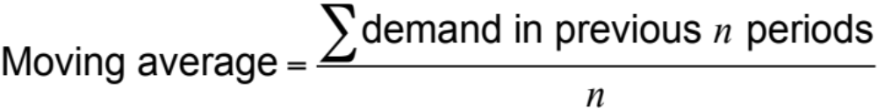
Moving Average Method
MA is a series of arithmetic means
Used if little or no trend
Used often for smoothing
  Provides overall impression of data over time

Slide 40
Moving Average Example
MONTH | ACTUAL SHED SALES | 3-MONTH MOVING AVERAGE
January | 10
February | 12
March | 13
April | 16
May | 19
June | 23
July | 26
August | 30
September | 28
October | 18
November | 16
December | 14
10
12
13
(10 + 12 + 13)/3 = 11 ²/₃
(12 + 13 + 16)/3 = 13 ²/₃
(13 + 16 + 19)/3 = 16
(16 + 19 + 23)/3 = 19 ¹/₃
(19 + 23 + 26)/3 = 22 ²/₃
(23 + 26 + 30)/3 = 26 ¹/₃
(29 + 30 + 28)/3 = 28
(30 + 28 + 18)/3 = 25 ¹/₃
(28 + 18 + 16)/3 = 20 ²/₃

Slide 41
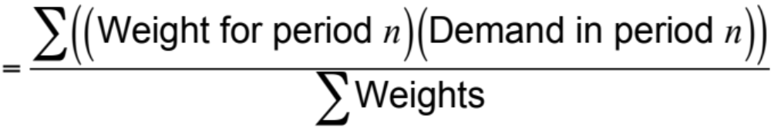
Weighted Moving Average
Used when some trend might be present
  Older data usually less important
Weights based on experience and intuition
Weighted moving average

Slide 42
Weighted Moving Average
MONTH | ACTUAL SHED SALES | 3-MONTH WEIGHTED MOVING AVERAGE
January | 10
February | 12
March | 13
April | 16
May | 19
June | 23
July | 26
August | 30
September | 28
October | 18
November | 16
December | 14
10
12
13
[(3 x 13) + (2 x 12) + (10)]/6 = 12 ¹/₆
WEIGHTS APPLIED |  |  |  | PERIOD
 |  | 3 |  | Last month
 |  | 2 |  | Two months ago
 |  | 1 |  | Three months ago
 |  | 6 |  | Sum of the weights
Forecast for this month =
3 x Sales last mo. + 2 x Sales 2 mos. ago + 1 x Sales 3 mos. ago
 | Sum of the weights

Slide 43
Weighted Moving Average
MONTH | ACTUAL SHED SALES | 3-MONTH WEIGHTED MOVING AVERAGE
January | 10
February | 12
March | 13
April | 16
May | 19
June | 23
July | 26
August | 30
September | 28
October | 18
November | 16
December | 14
10
12
13
[(3 x 13) + (2 x 12) + (10)]/6 = 12 ¹/₆
[(3 x 16) + (2 x 13) + (12)]/6 = 14 ¹/₃
[(3 x 19) + (2 x 16) + (13)]/6 = 17
[(3 x 23) + (2 x 19) + (16)]/6 = 20 ¹/₂
[(3 x 26) + (2 x 23) + (19)]/6 = 23 ⁵/₆
[(3 x 30) + (2 x 26) + (23)]/6 = 27 ¹/₂
[(3 x 28) + (2 x 30) + (26)]/6 = 28 ¹/₃
[(3 x 18) + (2 x 28) + (30)]/6 = 23 ¹/₃
[(3 x 16) + (2 x 18) + (28)]/6 = 18 ²/₃

Slide 44
Potential Problems With
Moving Average
Increasing n smooths the forecast but makes it less sensitive to changes
Does not forecast trends well
Requires extensive historical data

Slide 45
Class practice 1 (P)
Sales of hair dryers at the Walgreens stores in Youngstown, Ohio, over the past 4 months have been 100, 110, 120, and 130 units (with 130 being the most recent sales).
Develop a moving-average forecast for next month, using these three techniques:
a) 3-month moving average.
b) 4-month moving average.
c) Weighted 4-month moving average with the most recent month weighted 4, the preceding month 3, then 2, and the oldest month weighted 1.
d) If next month’s sales turn out to be 140 units, forecast the following month’s sales (months) using a 4-month moving average.

Slide 46
Graph of Moving Averages
Weighted moving average
30 –
25 –
20 –
15 –
10 –
5 –
Sales demand
Actual sales
Moving average
| | | | | | | | | | | |
J F M A M J J A S O N D
Figure 4.2
Month

Slide 47
Exponential Smoothing
Form of weighted moving average
  Weights decline exponentially
  Most recent data weighted most
Requires smoothing constant (α)
  Ranges from 0 to 1
  Subjectively chosen
Involves little record keeping of past data

Slide 48
Exponential Smoothing
New forecast = Last period’s forecast
+ α (Last period’s actual demand
– Last period’s forecast)
F_{t} = F_{t – 1} + α(A_{t – 1} - F_{t – 1})
where F_{t} = new forecast
F_{t – 1} = previous period’s forecast
α = smoothing (or weighting) constant (0 ≤ α ≤ 1)
A_{t – 1} = previous period’s actual demand

Slide 49
Example Exponential smoothing
In January, a car dealer predicted February demand for 142 Ford Mustangs. Actual February demand was 153 autos. Using a smoothing constant chosen by management of a = .20, the dealer wants to forecast March demand using the exponential smoothing model.

Slide 50
Exponential Smoothing Example
Predicted demand = 142 Ford Mustangs
Actual demand = 153
Smoothing constant α = .20

Slide 51
Exponential Smoothing Example
Predicted demand = 142 Ford Mustangs
Actual demand = 153
Smoothing constant α = .20
New forecast = 142 + .2(153 – 142)

Slide 52
Exponential Smoothing Example
Predicted demand = 142 Ford Mustangs
Actual demand = 153
Smoothing constant α = .20
New forecast = 142 + .2(153 – 142)
= 142 + 2.2
= 144.2 ≈ 144 cars

Slide 53
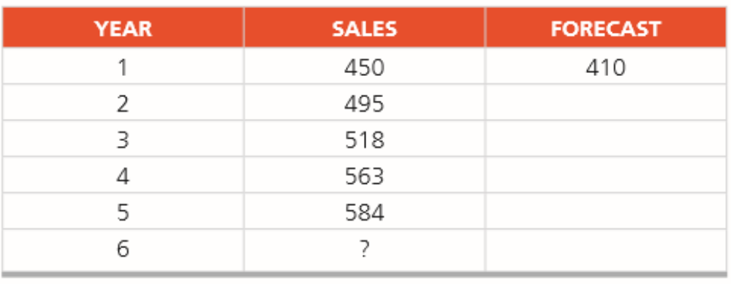
Class practice 2 (p2)
Sales of Volkswagen’s popular Beetle have grown steadily at auto dealerships in Nevada during the past 5 years (see table below). The sales manager had predicted before the new model was introduced that first year sales would be 410 VWs. Using exponential smoothing with a weight of a α =.30, develop forecasts for years 2 through 6.

Slide 54
Effect of
Smoothing Constants
Smoothing constant generally .05 ≤ α ≤ .50
As α increases, older values become less significant
WEIGHT ASSIGNED TO
SMOOTHING CONSTANT | MOST RECENT PERIOD (α) | 2ND MOST RECENT PERIOD α(1 – α) | 3RD MOST RECENT PERIOD α(1 – α)² | 4th MOST RECENT PERIOD α(1 – α)³ | 5th MOST RECENT PERIOD α(1 – α)⁴
α = .1 | .1 | .09 | .081 | .073 | .066
α = .5 | .5 | .25 | .125 | .063 | .031

Slide 55
Impact of Different α
225 –
200 –
175 –
150 –
Actual demand
α = .5
Demand
α = .1
| | | | | | | | |
1 2 3 4 5 6 7 8 9
Quarter

Slide 56
Impact of Different α
225 –
200 –
175 –
150 –
Actual demand
α = .5
Chose high values of α when underlying average is likely to change
Choose low values of α when underlying average is stable
Demand
α = .1
| | | | | | | | |
1 2 3 4 5 6 7 8 9
Quarter

Slide 57
Choosing α
The objective is to obtain the most accurate forecast no matter the technique
We generally do this by selecting the model that gives us the lowest forecast error
Forecast error = Actual demand – Forecast value
= A_{t} – F_{t}

Slide 58
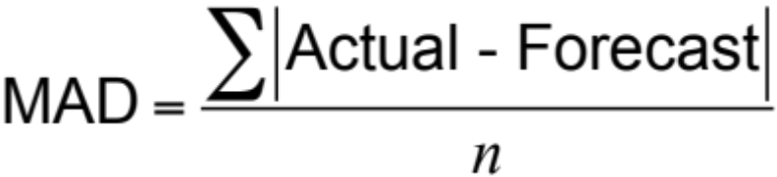
Common Measures of Error
Three common types of measurements.
1. Mean Absolute Deviation (MAD)
2. Mean Squared Error (MSE)
3. Mean Absolute Percent Error (MAPE)
Mean Absolute Deviation (MAD)

Slide 59
Example 4
During the past 8 quarters, the Port of Baltimore has unloaded large quantities of grain from ships. The port’s operations manager wants to test the use of exponential smoothing to see how well the technique works in predicting tonnage unloaded. He guesses that the forecast of grain unloaded in the first quarter was 175 tons. Two values of a are to be examined: a = .10 and a = .50.

Slide 60
Determining the MAD
QUARTER | ACTUAL TONNAGE UNLOADED | FORECAST WITH α = .10 | FORECAST WITH α = .50
1 | 180 | 175 | 175
2 | 168 | 175.50 = 175.00 + .10(180 – 175) | 177.50
3 | 159 | 174.75 = 175.50 + .10(168 – 175.50) | 172.75
4 | 175 | 173.18 = 174.75 + .10(159 – 174.75) | 165.88
5 | 190 | 173.36 = 173.18 + .10(175 – 173.18) | 170.44
6 | 205 | 175.02 = 173.36 + .10(190 – 173.36) | 180.22
7 | 180 | 178.02 = 175.02 + .10(205 – 175.02) | 192.61
8 | 182 | 178.22 = 178.02 + .10(180 – 178.02) | 186.30
9 | ? | 178.59 = 178.22 + .10(182 – 178.22) | 184.15

Slide 61
Determining the MAD
QUARTER | ACTUAL TONNAGE UNLOADED | FORECAST WITH α = .10 | ABSOLUTE DEVIATION FOR a = .10 |  |  | FORECAST WITH α = .50 | ABSOLUTE DEVIATION FOR a = .50
1 | 180 | 175 |  | 5.00 |  | 175 |  | 5.00
2 | 168 | 175.50 |  | 7.50 |  | 177.50 |  | 9.50
3 | 159 | 174.75 |  | 15.75 |  | 172.75 |  | 13.75
4 | 175 | 173.18 |  | 1.82 |  | 165.88 |  | 9.12
5 | 190 | 173.36 |  | 16.64 |  | 170.44 |  | 19.56
6 | 205 | 175.02 |  | 29.98 |  | 180.22 |  | 24.78
7 | 180 | 178.02 |  | 1.98 |  | 192.61 |  | 12.61
8 | 182 | 178.22 |  | 3.78 |  | 186.30 |  | 4.30
Sum of absolute deviations: |  |  |  | 82.45 |  |  |  | 98.62
MAD = |  | Σ|Deviations| |  | 10.31 |  |  |  | 12.33
 |  | n

Slide 62
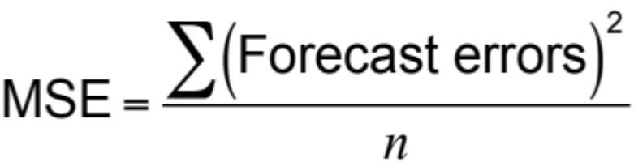
Common Measures of Error
Mean Squared Error (MSE)

Slide 63
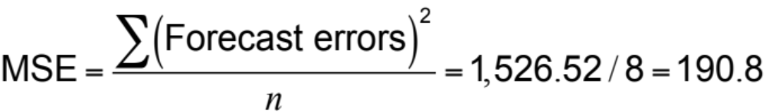
Determining the MSE
QUARTER | ACTUAL TONNAGE UNLOADED | FORECAST FOR α = .10 |  | (ERROR)²
1 | 180 | 175 |  | 5² = 25
2 | 168 | 175.50 |  | (–7.5)² = 56.25
3 | 159 | 174.75 |  | (–15.75)² = 248.06
4 | 175 | 173.18 |  | (1.82)² = 3.31
5 | 190 | 173.36 |  | (16.64)² = 276.89
6 | 205 | 175.02 |  | (29.98)² = 898.80
7 | 180 | 178.02 |  | (1.98)² = 3.92
8 | 182 | 178.22 |  | (3.78)² = 14.29
 |  | Sum of errors squared = 1,526.52

Slide 64
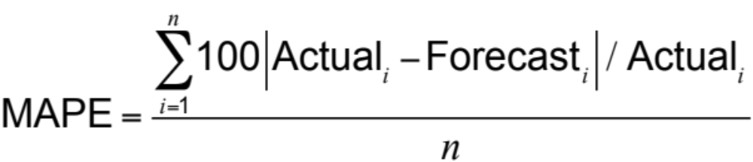
Common Measures of Error
Mean Absolute Percent Error (MAPE)

Slide 65
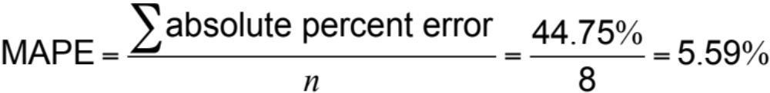
Determining the MAPE
QUARTER | ACTUAL TONNAGE UNLOADED | FORECAST FOR α = .10 | ABSOLUTE PERCENT ERROR 100(ERROR/ACTUAL)
1 | 180 | 175.00 |  | 100(5/180) = 2.78%
2 | 168 | 175.50 |  | 100(7.5/168) = 4.46%
3 | 159 | 174.75 |  | 100(15.75/159) = 9.90%
4 | 175 | 173.18 |  | 100(1.82/175) = 1.05%
5 | 190 | 173.36 |  | 100(16.64/190) = 8.76%
6 | 205 | 175.02 |  | 100(29.98/205) = 14.62%
7 | 180 | 178.02 |  | 100(1.98/180) = 1.10%
8 | 182 | 178.22 |  | 100(3.78/182) = 2.08%
 |  | Sum of % errors = 44.75%

Slide 66
Comparison of Forecast Error
Rounded Absolute Rounded Absolute
Actual Forecast Deviation Forecast Deviation
Tonnage with for with for
Quarter Unloaded α = .10 α = .10 α = .50 α = .50
1 180 175 5.00 175 5.00
2 168 175.5 7.50 177.50 9.50
3 159 174.75 15.75 172.75 13.75
4 175 173.18 1.82 165.88 9.12
5 190 173.36 16.64 170.44 19.56
6 205 175.02 29.98 180.22 24.78
7 180 178.02 1.98 192.61 12.61
8 182 178.22 3.78 186.30 4.30
82.45 98.62

Slide 67
Comparison of Forecast Error
∑ |deviations|
n
Rounded Absolute Rounded Absolute
Actual Forecast Deviation Forecast Deviation
Tonnage with for with for
Quarter Unloaded a = .10 a = .10 α = .50 α = .50
MAD =
For α = .10
1 180 175 5.00 175 5.00
2 168 175.5 7.50 177.50 9.50
3 159 174.75 15.75 172.75 13.75
4 175 173.18 1.82 165.88 9.12
5 190 173.36 16.64 170.44 19.56
6 205 175.02 29.98 180.22 24.78
7 180 178.02 1.98 192.61 12.61
8 182 178.22 3.78 186.30 4.30
82.45 98.62
= 82.45/8 = 10.31
For α = .50
= 98.62/8 = 12.33

Slide 68
Comparison of Forecast Error
∑ (forecast errors)²
n
Rounded Absolute Rounded Absolute
Actual Forecast Deviation Forecast Deviation
Tonnage with for with for
Quarter Unloaded a = .10 a = .10 α = .50 α = .50
MSE =
For α = .10
1 180 175 5.00 175 5.00
2 168 175.5 7.50 177.50 9.50
3 159 174.75 15.75 172.75 13.75
4 175 173.18 1.82 165.88 9.12
5 190 173.36 16.64 170.44 19.56
6 205 175.02 29.98 180.22 24.78
7 180 178.02 1.98 192.61 12.61
8 182 178.22 3.78 186.30 4.30
82.45 98.62
MAD 10.31 12.33
= 1,526.54/8 = 190.82
For α = .50
= 1,561.91/8 = 195.24

Slide 69
Comparison of Forecast Error
n
i = 1
∑100|deviation_{i}|/actual_{i}
n
Rounded Absolute Rounded Absolute
Actual Forecast Deviation Forecast Deviation
Tonnage with for with for
Quarter Unloaded a = .10 a = .10 a = .50 α = .50
MAPE =
For α = .10
1 180 175 5.00 175 5.00
2 168 175.5 7.50 177.50 9.50
3 159 174.75 15.75 172.75 13.75
4 175 173.18 1.82 165.88 9.12
5 190 173.36 16.64 170.44 19.56
6 205 175.02 29.98 180.22 24.78
7 180 178.02 1.98 192.61 12.61
8 182 178.22 3.78 186.30 4.30
82.45 98.62
MAD 10.31 12.33
MSE 190.82 195.24
= 44.75/8 = 5.59%
For α = .50
= 54.05/8 = 6.76%

Slide 70
Comparison of Forecast Error
Rounded Absolute Rounded Absolute
Actual Forecast Deviation Forecast Deviation
Tonnage with for with for
Quarter Unloaded α = .10 α = .10 α = .50 α = .50
1 180 175 5.00 175 5.00
2 168 175.5 7.50 177.50 9.50
3 159 174.75 15.75 172.75 13.75
4 175 173.18 1.82 165.88 9.12
5 190 173.36 16.64 170.44 19.56
6 205 175.02 29.98 180.22 24.78
7 180 178.02 1.98 192.61 12.61
8 182 178.22 3.78 186.30 4.30
82.45 98.62
MAD 10.31 12.33
MSE 190.82 195.24
MAPE 5.59% 6.76%

Slide 71
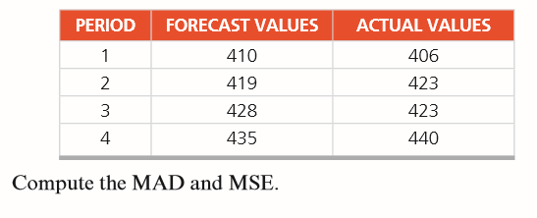
Class practice 3 (p3)
The following data come from regression line projections:

Slide 72
Trend Projections
Fitting a trend line to historical data points to project into the medium to long-range
Linear trends can be found using the least squares technique
^
y = a + bx
^
where y = computed value of the variable to be predicted (dependent variable)
a = y-axis intercept
b = slope of the regression line
x = the independent variable

Slide 73
Least Squares Method
Actual observation
(y-value)
Deviation₇
Deviation₅
Deviation₆
Values of Dependent Variable (y-values)
Deviation₃
Least squares method minimizes the sum of the squared errors (deviations)
Deviation₄
Deviation₁
(error)
Deviation₂
^
Trend line, y = a + bx
| | | | | | |
1 2 3 4 5 6 7
Time period
Figure 4.4

Slide 74

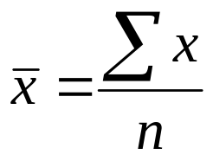
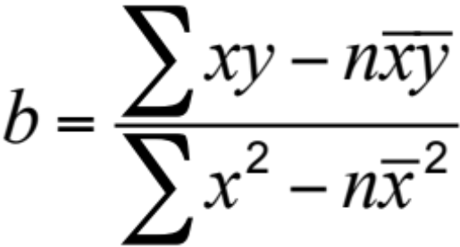
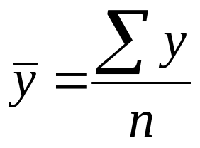

Least Squares Method
Equations to calculate the regression variables

Slide 75
Least Squares Example S
The demand for electric power at N.Y. Edison over the past 7 years is shown in the following table, in megawatts. The firm wants to forecast next year’s demand by fitting a straight-line trend to these data
YEAR | ELECTRICAL POWER DEMAND | YEAR | ELECTRICAL POWER DEMAND
1 | 74 | 5 | 105
2 | 79 | 6 | 142
3 | 80 | 7 | 122
4 | 90

Slide 76

Least Squares Example
YEAR (x) |  |  | ELECTRICAL POWER DEMAND (y) |  |  | x² |  |  | xy
 | 1 |  |  | 74 |  |  | 1 |  |  | 74
 | 2 |  |  | 79 |  |  | 4 |  |  | 158
 | 3 |  |  | 80 |  |  | 9 |  |  | 240
 | 4 |  |  | 90 |  |  | 16 |  |  | 360
 | 5 |  |  | 105 |  |  | 25 |  |  | 525
 | 6 |  |  | 142 |  |  | 36 |  |  | 852
 | 7 |  |  | 122 |  |  | 49 |  |  | 854
Σx = 28 |  |  | Σy = 692 |  |  | Σx² = 140 |  |  | Σxy = 3,063

Slide 77
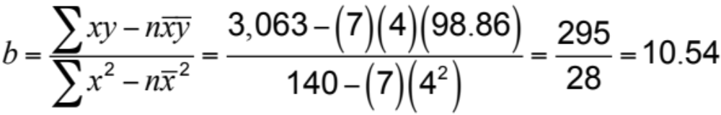


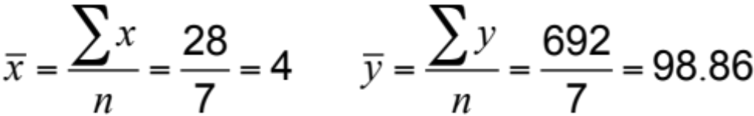
Least Squares Example
YEAR (x) |  |  | ELECTRICAL POWER DEMAND (y) |  |  | x² |  |  | xy
 | 1 |  |  | 74 |  |  | 1 |  |  | 74
 | 2 |  |  | 79 |  |  | 4 |  |  | 158
 | 3 |  |  | 80 |  |  | 9 |  |  | 240
 | 4 |  |  | 90 |  |  | 16 |  |  | 360
 | 5 |  |  | 105 |  |  | 25 |  |  | 525
 | 6 |  |  | 142 |  |  | 36 |  |  | 852
 | 7 |  |  | 122 |  |  | 49 |  |  | 854
Σx = 28 |  |  | Σy = 692 |  |  | Σx² = 140 |  |  | Σxy = 3,063
Demand in year 8 = 56.70 + 10.54(8)
= 141.02, or 141 megawatts

Slide 78
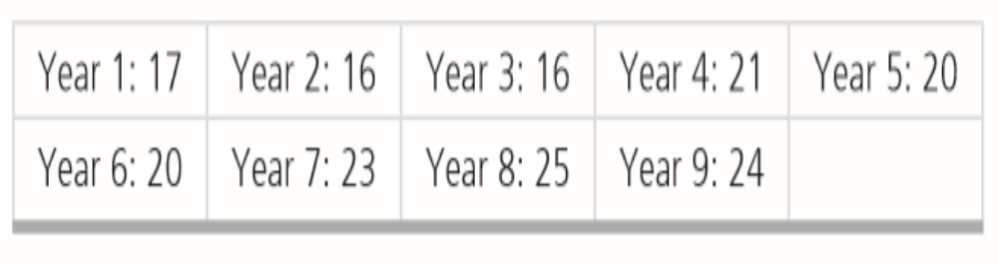
Class practice 4 (p4)
Room registrations in the Toronto Towers Plaza Hotel have been recorded for the past 9 years. To project future occupancy, management would like to determine the mathematical trend of guest registration. This estimate will help the hotel determine whether future expansion will be needed. Given the following time-series data, develop a regression equation relating registrations to time (e.g., a trend equation). Then forecast year 11 registrations. Room registrations are in the thousands:

Slide 79
Least Squares Example
Trend line,
y = 56.70 + 10.54x
160 –
150 –
140 –
130 –
120 –
110 –
100 –
90 –
80 –
70 –
60 –
50 –
^
Power demand (megawatts)
| | | | | | | | |
1 2 3 4 5 6 7 8 9
Year
Figure 4.5

Slide 80
Least Squares Requirements
We always plot the data to insure a linear relationship
We do not predict time periods far beyond the database
Deviations around the least squares line are assumed to be random

Slide 81


Seasonal Variations In Data
The multiplicative seasonal model can adjust trend data for seasonal variations in demand

Slide 82
Seasonal Variations In Data
Steps in the process for monthly seasons:
Find average historical demand for each month
Compute the average demand over all months
Compute a seasonal index for each month
Estimate next year’s total demand
Divide this estimate of total demand by the number of months, then multiply it by the seasonal index for that month

Slide 83
Seasonal Index Example
A Des Moines distributor of Sony laptop computers wants to develop monthly indices for sales. Data from the past 3 years, by month, are available.
 | DEMAND
MONTH | YEAR 1 | YEAR 2 | YEAR 3 | AVERAGE YEARLY DEMAND |  |  | AVERAGE MONTHLY DEMAND | SEASONAL INDEX
Jan | 80 | 85 | 105
Feb | 70 | 85 | 85
Mar | 80 | 93 | 82
Apr | 90 | 95 | 115
May | 113 | 125 | 131
June | 110 | 115 | 120
July | 100 | 102 | 113
Aug | 88 | 102 | 110
Sept | 85 | 90 | 95
Oct | 77 | 78 | 85
Nov | 75 | 82 | 83
Dec | 82 | 78 | 80
90
80
85
100
123
115
105
100
90
80
80
80
Total average annual demand = 1,128

Slide 84
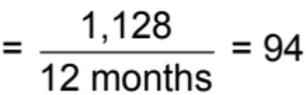
Seasonal Index Example
 | DEMAND
MONTH | YEAR 1 | YEAR 2 | YEAR 3 | AVERAGE YEARLY DEMAND |  |  | AVERAGE MONTHLY DEMAND | SEASONAL INDEX
Jan | 80 | 85 | 105 |  | 90 |  | 94
Feb | 70 | 85 | 85 |  | 80 |  | 94
Mar | 80 | 93 | 82 |  | 85 |  | 94
Apr | 90 | 95 | 115 |  | 100 |  | 94
May | 113 | 125 | 131 |  | 123 |  | 94
June | 110 | 115 | 120 |  | 115 |  | 94
July | 100 | 102 | 113 |  | 105 |  | 94
Aug | 88 | 102 | 110 |  | 100 |  | 94
Sept | 85 | 90 | 95 |  | 90 |  | 94
Oct | 77 | 78 | 85 |  | 80 |  | 94
Nov | 75 | 82 | 83 |  | 80 |  | 94
Dec | 82 | 78 | 80 |  | 80 |  | 94
Total average annual demand = |  |  |  |  | 1,128
Average monthly demand

Slide 85
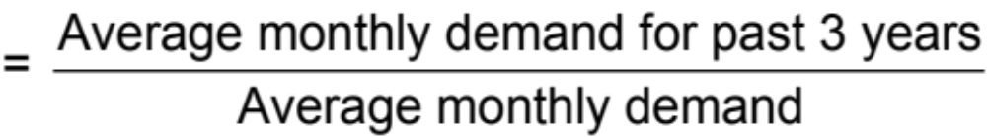
Seasonal Index Example
 | DEMAND
MONTH | YEAR 1 | YEAR 2 | YEAR 3 | AVERAGE YEARLY DEMAND |  |  | AVERAGE MONTHLY DEMAND | SEASONAL INDEX
Jan | 80 | 85 | 105 |  | 90 |  | 94
Feb | 70 | 85 | 85 |  | 80 |  | 94
Mar | 80 | 93 | 82 |  | 85 |  | 94
Apr | 90 | 95 | 115 |  | 100 |  | 94
May | 113 | 125 | 131 |  | 123 |  | 94
June | 110 | 115 | 120 |  | 115 |  | 94
July | 100 | 102 | 113 |  | 105 |  | 94
Aug | 88 | 102 | 110 |  | 100 |  | 94
Sept | 85 | 90 | 95 |  | 90 |  | 94
Oct | 77 | 78 | 85 |  | 80 |  | 94
Nov | 75 | 82 | 83 |  | 80 |  | 94
Dec | 82 | 78 | 80 |  | 80 |  | 94
Total average annual demand = |  |  |  |  | 1,128
.957( = 90/94)
Seasonal index

Slide 86
Seasonal Index Example
 | DEMAND
MONTH | YEAR 1 | YEAR 2 | YEAR 3 | AVERAGE YEARLY DEMAND |  |  | AVERAGE MONTHLY DEMAND | SEASONAL INDEX
Jan | 80 | 85 | 105 |  | 90 |  | 94 | .957( = 90/94)
Feb | 70 | 85 | 85 |  | 80 |  | 94 | .851( = 80/94)
Mar | 80 | 93 | 82 |  | 85 |  | 94 | .904( = 85/94)
Apr | 90 | 95 | 115 |  | 100 |  | 94 | 1.064( = 100/94)
May | 113 | 125 | 131 |  | 123 |  | 94 | 1.309( = 123/94)
June | 110 | 115 | 120 |  | 115 |  | 94 | 1.223( = 115/94)
July | 100 | 102 | 113 |  | 105 |  | 94 | 1.117( = 105/94)
Aug | 88 | 102 | 110 |  | 100 |  | 94 | 1.064( = 100/94)
Sept | 85 | 90 | 95 |  | 90 |  | 94 | .957( = 90/94)
Oct | 77 | 78 | 85 |  | 80 |  | 94 | .851( = 80/94)
Nov | 75 | 82 | 83 |  | 80 |  | 94 | .851( = 80/94)
Dec | 82 | 78 | 80 |  | 80 |  | 94 | .851( = 80/94)
Total average annual demand = |  |  |  |  | 1,128

Slide 87
Seasonal Index Example
If we expect the annual demand for computers to be 1,200 units next year, we would use these seasonal indices to forecast the monthly demand as follows:
Seasonal forecast for Year 4
MONTH | DEMAND |  |  | MONTH | DEMAND
Jan |  | 1,200 | x .957 = 96 | July |  | 1,200 | x 1.117 = 112
 |  | 12 |  |  |  | 12
Feb |  | 1,200 | x .851 = 85 | Aug |  | 1,200 | x 1.064 = 106
 |  | 12 |  |  |  | 12
Mar |  | 1,200 | x .904 = 90 | Sept |  | 1,200 | x .957 = 96
 |  | 12 |  |  |  | 12
Apr |  | 1,200 | x 1.064 = 106 | Oct |  | 1,200 | x .851 = 85
 |  | 12 |  |  |  | 12
May |  | 1,200 | x 1.309 = 131 | Nov |  | 1,200 | x .851 = 85
 |  | 12 |  |  |  | 12
June |  | 1,200 | x 1.223 = 122 | Dec |  | 1,200 | x .851 = 85
 |  | 12 |  |  |  | 12

Slide 88
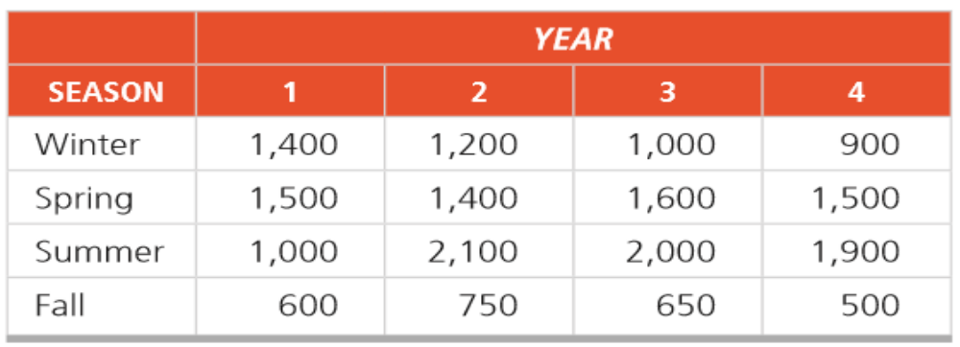
Class practice 5
4.26 George Kyparisis owns a company that manufactures sailboats. Actual demand for George’s sailboats during each of the past four seasons was as follows:
George has forecasted that annual demand for his sailboats in year 5 will equal 5,600 sailboats. Based on this data and the multiplicative seasonal model, what will the demand level be for George’s sailboats in the spring of year 5?

Slide 89
Seasonal Index Example
Year 4 Forecast
Year 3 Demand
Year 2 Demand
Year 1 Demand
140 –
130 –
120 –
110 –
100 –
90 –
80 –
70 –
Demand
| | | | | | | | | | | |
J F M A M J J A S O N D
Time

Slide 90
San Diego Hospital
San Diego Hospital wants to improve its forecasting by applying both trend and seasonal indices to 66 months of data it has collected. It will then forecast “patient-days” over the coming year.
Trend Data
Figure 4.6
10,200 –
10,000 –
9,800 –
9,600 –
9,400 –
9,200 –
9,000 –
9702
9745
9616
9659
Inpatient Days
9530
9573
9724
9766
9637
9680
9551
9594
| | | | | | | | | | | |
Jan Feb Mar Apr May June July Aug Sept Oct Nov Dec
67 68 69 70 71 72 73 74 75 76 77 78
Month

Slide 91
San Diego Hospital
 | Seasonality Indices for Adult Inpatient Days at San Diego Hospital
MONTH | SEASONALITY INDEX | MONTH | SEASONALITY INDEX
January | 1.04 | July | 1.03
February | 0.97 | August | 1.04
March | 1.02 | September | 0.97
April | 1.01 | October | 1.00
May | 0.99 | November | 0.96
June | 0.99 | December | 0.98

Slide 92
San Diego Hospital
Seasonal Indices
Figure 4.7
1.06 –
1.04 –
1.02 –
1.00 –
0.98 –
0.96 –
0.94 –
0.92 –
1.04
1.04
1.03
1.02
1.01
1.00
0.99
Index for Inpatient Days
0.98
0.99
0.97
0.97
0.96
| | | | | | | | | | | |
Jan Feb Mar Apr May June July Aug Sept Oct Nov Dec
67 68 69 70 71 72 73 74 75 76 77 78
Month

Slide 93
San Diego Hospital
Period | 67 | 68 | 69 | 70 | 71 | 72
Month | Jan | Feb | Mar | Apr | May | June
Forecast with Trend & Seasonality | 9,911 | 9,265 | 9,164 | 9,691 | 9,520 | 9,542
Period | 73 | 74 | 75 | 76 | 77 | 78
Month | July | Aug | Sept | Oct | Nov | Dec
Forecast with Trend & Seasonality | 9,949 | 10,068 | 9,411 | 9,724 | 9,355 | 9,572

Slide 94
San Diego Hospital
Combined Trend and Seasonal Forecast
Figure 4.8
10,200 –
10,000 –
9,800 –
9,600 –
9,400 –
9,200 –
9,000 –
10068
9911
9949
9764
9724
9691
Inpatient Days
9572
9520
9542
9411
9265
9355
| | | | | | | | | | | |
Jan Feb Mar Apr May June July Aug Sept Oct Nov Dec
67 68 69 70 71 72 73 74 75 76 77 78
Month

Slide 95
Example 4.25
In the past, Peter Kelle’s tire dealership in Baton Rouge sold an average of 1,000 radials each year. In the past 2 years, 200 and 250, respectively, were sold in fall, 350 and 300 in winter, 150 and 165 in spring, and 300 and 285 in summer. With a major expansion planned, Kelle projects sales next year to increase to 1,200 radials. What will be the demand during each season?

Slide 96
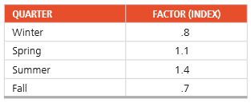
Example 4.28
North Dakota Electric Company estimates its demand trend line (in millions of kilowatt hours) to be:
D = 77 + 0.43Q
here Q refers to the sequential quarter number and Q 5 1 for winter of Year 1. In addition, the multiplicative seasonal factors are as follows:
Forecast energy use for the four quarters of year 26 (namely quarters 101 to 104), beginning with winter.

Slide 97
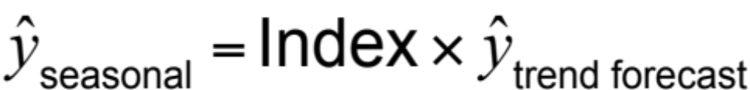
Adjusting Trend Data with Seasonal indices
Management at Jagoda Wholesalers, in Calgary, Canada, has used time-series regression based on pointof-sale data to forecast sales for the next 4 quarters. Sales estimates are $100,000, $120,000, $140,000, and $160,000 for the respective quarters. Seasonal indices for the four quarters have been found to be 1.30, .90, .70, and 1.10, respectively.

Slide 98
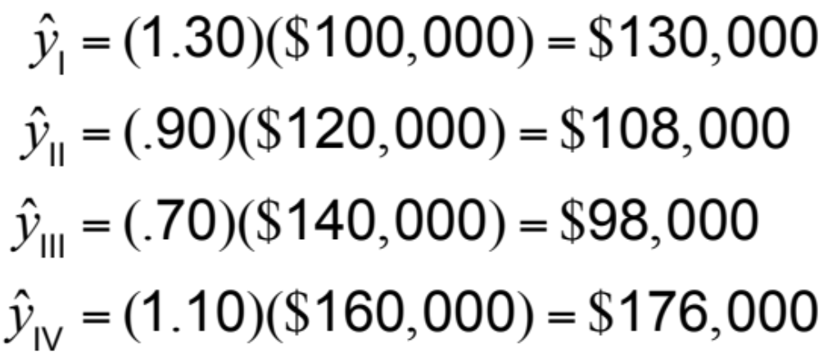
Adjusting Trend Data
Quarter I:
Quarter II:
Quarter III:
Quarter IV:

Slide 99
Problem 4.6
Quarterly demand for Ford F150 pickups at a New York auto dealer is forecast with the equation:
yn = 10 + 3x where x = quarters, and:
Quarter I of year 1 = 0
Quarter II of year 1 = 1
Quarter III of year 1 = 2
Quarter IV of year 1 = 3
Quarter I of year 2 = 4 and
so on and:
y n = quarterly demand
The demand for trucks is seasonal, and the indices for Quarters I, II, III, and IV are 0.80, 1.00, 1.30, and 0.90, respectively. Forecast demand for each quarter of year 3. Then, seasonalize each forecast to adjust for quarterly variations.

Slide 100
Associative Forecasting
Forecasting an outcome based on predictor variables using the least squares technique
^
y = a + bx
^
where y = value of the dependent variable (in our example, sales)
a = y-axis intercept
b = slope of the regression line
x = the independent variable

Slide 101
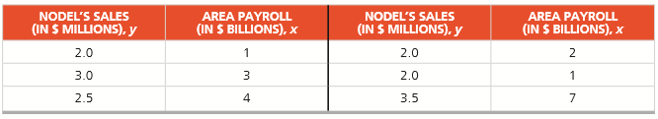
Example 12
Nodel Construction Company renovates old homes in West Bloomfield, Michigan. Over time, the company has found that its dollar volume of renovation work is dependent on the West Bloomfield area payroll. Management wants to establish a mathematical relationship to help predict sales.

Slide 102
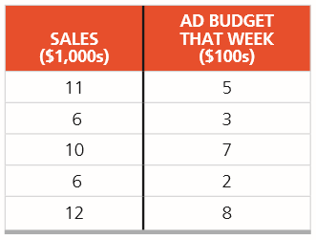
Problem 4.7
Cengiz Haksever runs an Istanbul high-end jewelry shop. He advertises weekly in local Turkish newspapers and is thinking of increasing his ad budget. Before doing so, he decides to evaluate the past effectiveness of these ads. Five weeks are sampled, and the data are shown in the table below:
Develop a regression model to help Cengiz evaluate his advertising.

Slide 103
Associative Forecasting Example
NODEL’S SALES (IN $ MILLIONS), y | AREA PAYROLL (IN $ BILLIONS), x | NODEL’S SALES (IN $ MILLIONS), y | AREA PAYROLL (IN $ BILLIONS), x
2.0 | 1 | 2.0 | 2
3.0 | 3 | 2.0 | 1
2.5 | 4 | 3.5 | 7
4.0 –
3.0 –
2.0 –
1.0 –
Nodel’s sales
(in$ millions)
| | | | | | |
0 1 2 3 4 5 6 7
Area payroll (in $ billions)

Slide 104
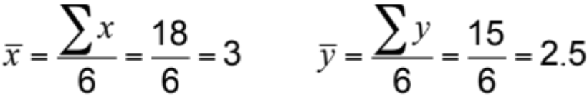
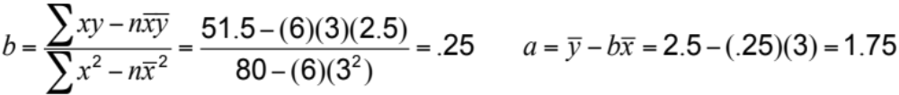
Associative Forecasting Example
SALES, y |  |  | PAYROLL, x |  |  |  | x² |  |  | xy
 | 2.0 |  |  | 1 |  |  | 1 |  |  | 2.0
 | 3.0 |  |  | 3 |  |  | 9 |  |  | 9.0
 | 2.5 |  |  | 4 |  |  | 16 |  |  | 10.0
 | 2.0 |  |  | 2 |  |  | 4 |  |  | 4.0
 | 2.0 |  |  | 1 |  |  | 1 |  |  | 2.0
 | 3.5 |  |  | 7 |  | 49 |  |  |  | 24.5
Σy = | 15.0 |  | Σx = | 18 |  | Σx² = | 80 |  | Σxy = | 51.5

Slide 105
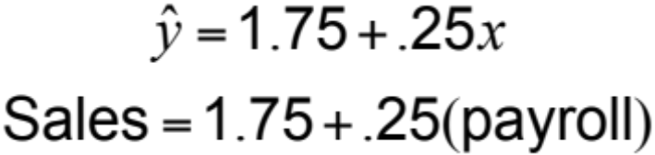
Associative Forecasting Example
SALES, y |  |  | PAYROLL, x |  |  |  | x² |  |  | xy
 | 2.0 |  |  | 1 |  |  | 1 |  |  | 2.0
 | 3.0 |  |  | 3 |  |  | 9 |  |  | 9.0
 | 2.5 |  |  | 4 |  |  | 16 |  |  | 10.0
 | 2.0 |  |  | 2 |  |  | 4 |  |  | 4.0
 | 2.0 |  |  | 1 |  |  | 1 |  |  | 2.0
 | 3.5 |  |  | 7 |  | 49 |  |  |  | 24.5
Σy = | 15.0 |  | Σx = | 18 |  | Σx² = | 80 |  | Σxy = | 51.5

Slide 106
Associative Forecasting Example
SALES, y |  |  | PAYROLL, x |  |  |  | x² |  |  | xy
 | 2.0 |  |  | 1 |  |  | 1 |  |  | 2.0
 | 3.0 |  |  | 3 |  |  | 9 |  |  | 9.0
 | 2.5 |  |  | 4 |  |  | 16 |  |  | 10.0
 | 2.0 |  |  | 2 |  |  | 4 |  |  | 4.0
 | 2.0 |  |  | 1 |  |  | 1 |  |  | 2.0
 | 3.5 |  |  | 7 |  | 49 |  |  |  | 24.5
Σy = | 15.0 |  | Σx = | 18 |  | Σx² = | 80 |  | Σxy = | 51.5
4.0 –
3.0 –
2.0 –
1.0 –
Nodel’s sales
(in$ millions)
| | | | | | |
0 1 2 3 4 5 6 7
Area payroll (in $ billions)

Slide 107
Associative Forecasting Example
If payroll next year is estimated to be $6 billion, then:
Sales (in $ millions) = 1.75 + .25(6)
= 1.75 + 1.5 = 3.25
Sales = $3,250,000

Slide 108
Associative Forecasting Example
4.0 –
3.0 –
2.0 –
1.0 –
If payroll next year is estimated to be $6 billion, then:
3.25
Nodel’s sales
(in$ millions)
Sales (in$ millions) = 1.75 + .25(6)
= 1.75 + 1.5 = 3.25
Sales = $3,250,000
| | | | | | |
0 1 2 3 4 5 6 7
Area payroll (in $ billions)

Slide 109

Standard Error of the Estimate
A forecast is just a point estimate of a future value
This point is
actually the
mean of a
probability
distribution
4.0 –
3.0 –
2.0 –
1.0 –
3.25
Nodel’s sales
(in$ millions)
Regression line,
| | | | | | |
0 1 2 3 4 5 6 7
Figure 4.9
Area payroll (in $ billions)

Slide 110
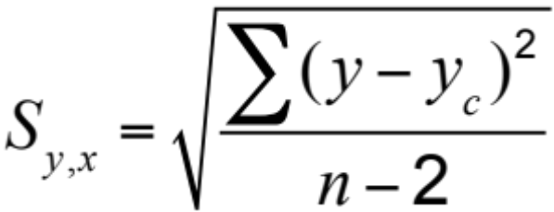
Standard Error of the Estimate
where y = y-value of each data point
y_{c} = computed value of the dependent variable, from the regression equation
n = number of data points

Slide 111
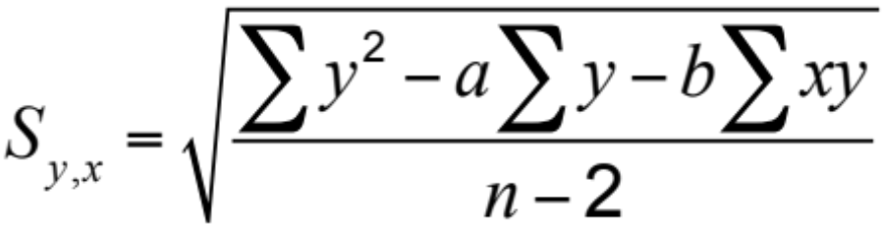
Standard Error of the Estimate
Computationally, this equation is considerably easier to use
We use the standard error to set up prediction intervals around the point estimate

Slide 112
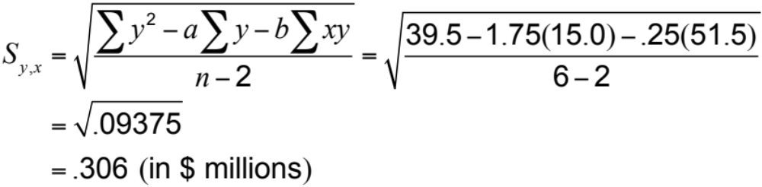
Standard Error of the Estimate
4.0 –
3.0 –
2.0 –
1.0 –
3.25
The standard error of the estimate is $306,000 in sales
Nodel’s sales
(in$ millions)
| | | | | | |
0 1 2 3 4 5 6 7
Area payroll (in $ billions)

Slide 113
Correlation
How strong is the linear relationship between the variables?
Correlation does not necessarily imply causality!
Coefficient of correlation, r, measures degree of association
  Values range from -1 to +1

Slide 114
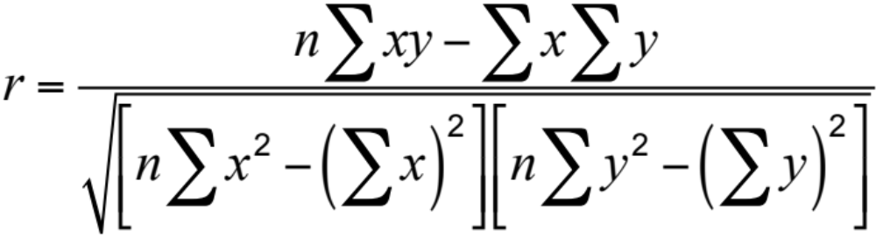
Correlation Coefficient

Slide 115
Correlation Coefficient
Figure 4.10
y
y
x
x
(a) Perfect negative correlation
(e) Perfect positive correlation
y
y
x
y
x
(b) Negative correlation
(d) Positive correlation
x
(c) No correlation
High
Moderate
Low
Low
Moderate
High
| | | | | | | | |
–1.0 –0.8 –0.6 –0.4 –0.2 0 0.2 0.4 0.6 0.8 1.0
Correlation coefficient values

Slide 116
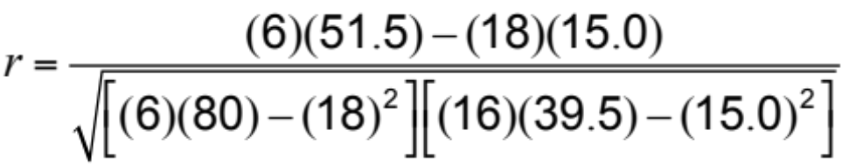
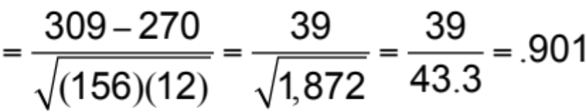
Correlation Coefficient
y |  |  | x |  |  |  | x² |  |  | xy |  |  | y²
 | 2.0 |  |  | 1 |  |  | 1 |  |  | 2.0 |  |  | 4.0
 | 3.0 |  |  | 3 |  |  | 9 |  |  | 9.0 |  |  | 9.0
 | 2.5 |  |  | 4 |  |  | 16 |  |  | 10.0 |  |  | 6.25
 | 2.0 |  |  | 2 |  |  | 4 |  |  | 4.0 |  |  | 4.0
 | 2.0 |  |  | 1 |  |  | 1 |  |  | 2.0 |  |  | 4.0
 | 3.5 |  |  | 7 |  | 49 |  |  |  | 24.5 |  |  | 12.25
Σy = | 15.0 |  | Σx = | 18 |  | Σx² = | 80 |  | Σxy = | 51.5 |  | Σy² = | 39.5

Slide 117
Correlation
Coefficient of Determination, r², measures the percent of change in y predicted by the change in x
  Values range from 0 to 1
  Easy to interpret
For the Nodel Construction example:
r = .901
r² = .81

Slide 118
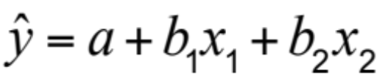
Multiple-Regression Analysis
If more than one independent variable is to be used in the model, linear regression can be extended to multiple regression to accommodate several independent variables
Computationally, this is quite complex and generally done on the computer

Slide 119
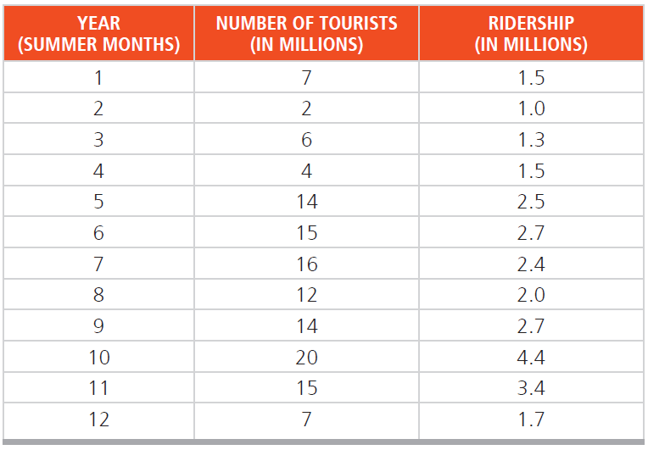

Class Practice
Bus and subway ridership for the summer months in London, England, is believed to be tied heavily to the number of tourists visiting the city. During the past 12 years, the data have been obtained:
a) Plot these data and decide if a linear model is reasonable.
b) Develop a regression relationship.
c) What is expected ridership if 10 million tourists visit London in a year?
d) Explain the predicted ridership if there are no tourists at all.
e) What is the standard error of the estimate?
f) What is the model’s correlation coefficient and coefficient of determination?

Slide 120
Case Video
Hard Rock Café
https://www.youtube.com/watch?v=wM7gul_jfY4

Slide 121

All rights reserved. No part of this publication may be reproduced, stored in a retrieval system, or transmitted, in any form or by any means, electronic, mechanical, photocopying, recording, or otherwise, without the prior written permission of the publisher.
Printed in the United States of America.

